Slide 1
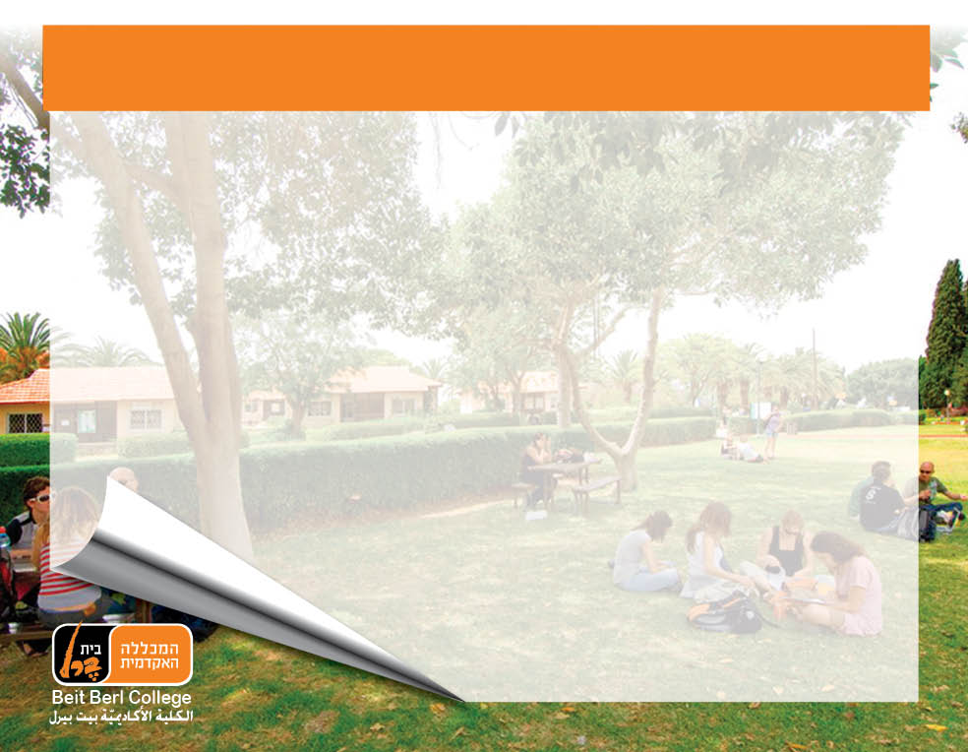
title
Dialogical Pedagogy and Creative Thinking
Maya Levanon, Ed.D. & Hait Shaham, PhD., Beit Berl College, Israel

Slide 2
What is Creative Thinking?
Intuitive and Sudden: causes a sensation of unease
Alternative Outlook & Solution/Welcomes Surprises: Cognitive Processes that break the Norms
Suspends Judgment
Interconnects ideas that have never been related before
Results in original, innovative, and valuable product (e.g.: Problem, Solution, Artifact, Idea, Theory)

Slide 3
The Importance of Creative Thinking
Solutions for Situations that seem dead-end
Refines what exists while lowering costs
Satisfaction, mental health, independence, confidence, flexibility
Encourages Breakthrough, Inventions, Patents
Adapting to the 21st Century required skills

Slide 4
21st Century Skills
Critical Thinking: Filtering and Processing Information
Handling Complex, Multi-Disciplinary Situations
Handling Open-Ended Questions
Creative, Innovative Thinking
Cognitive Flexibility
Decision Making
Communication & Partnership
Responsibility over one’s Finance, Health, and Civil matters
Scientific, Technological, Linguistic and Informative Fluency

Slide 5
What is Dialogical Pedagogy?
A Conversation that Invites a Dynamic Exchange of Ideas and Information
A Conversation in which Fertile Questions and Fundamental Concepts are being asked and analyzed
Answers/Solutions are formulated together
“Win win”
Participants are engaged in an Ongoing Interaction
Active Listening and Involvement
Constructivist Equality; Epistemological Equity
Participants are encouraged to bring their Authentic Voice
Suspending judgment and Automatic responses

Slide 6
Philosophical Dialogue and Creative Thinking, 1
3 obstacles for Creative Thinking:
Emotional
Conceptual
Intellectual
Authentic Dialogue, where we find an atmosphere of joint inquiry and no judgment, has the power to remove those blocks gradually and naturally

Slide 7
Philosophical Dialogue and Creative Thinking, 2
PD emphasizes Individual Autonomy (necessary for CT)
PD emphasizes Cooperative Thinking (surprisingly also necessary for CT)
Pushes away from one’s Cognitive Comfort Zone → different perspectives and epistemologies
Accepting different ideas and opinions
Requires a spontaneous product
Encourages reflection and self correctness

Slide 8
Research Model
Context: School/Academia (Academia Kita)
  Individualized hours (Ofek Hadash)
  Coursework: Strategies for Creative Thinking:
    Curriculum: Theories (Reading); Workshop-like Activities/Thinking Exercises
    Pedagogy: Socratic Dialogue/Peer led; jigsaw; interdisciplinary; PBL; Differentiated Instructions
    Summative Assessment: Creative Products, Self Evaluation of self in CI, teaching observations; Co-operative Learning; T&L Journal
Data Collection: Questionnaires, Analyzing Students Creative Products, In-Depth Interviews, Observations

Slide 9
???
Creative Thinking vs. Creativity
Philosophical Dialogue vs. Dialogical Pedagogy
Relevancy of Logical Argumentation in the Thinking Classroom
Importance of Product in the dialogical classroom
Process-product-individual
Critical Thinking
Meaning making
Dialogue and Creative Thinking → direction of Influence

Slide 10
Working references
Chappell, K., & Craft, C. (2011). Creative learning c onveration: Producing living dialogic spaces, Educational Research, 53:3, 363-385.
Davis, J. M. (2013). Supporting creativity, inclusion and collaboration multi-professional learning, Improving School , 16(1), 5-20.
Deverell, A., & Moore, S. (2014). Relasing creativity in teaching and learning: The potential role of organizational legitimacy and increased dialogue, Innovations in Education and Teaching International , 51(2), 164-174.
Gurteen, D. (1998). Knowledge, creativity and innovation, Journal of K nowledge Management, 2 (1), 5-13.
Korgel, B. A. (2002). Nurturing faculty-student dialogue, deep learning and creativity through Journal writing exercises, Journal of Engineering Education, 91(1), 143-146.

Slide 11
Working References
Martin, D. S., Craft, A. R., & Tillema ,H. H. (2002). Developing critical and creative thinking strategies in primary school pupils: An Inter-cultural study of teachers’ learning, Journal of In-Service Education, 28:1, 115-134.
Strern, J. (2013). Surprise in schools: Martin Buber and dialogue schooling, FORUM,
55 (1),45-58.
Wegerif, R. (2005). Reason and creativity in classroom dialogues, Language and Education, 19(3), 223-237.

Slide 12


